Slide 1
Rent a car
Made by: iviyan stoyanov, Katerina slavovA, Georgi gochev

Slide 2



USED LANGUAGES
Html css c#

Slide 3
Home page
Include list of cars that are coming soon
List of top 3 most used cars
And top 3 cars with best value

Slide 4
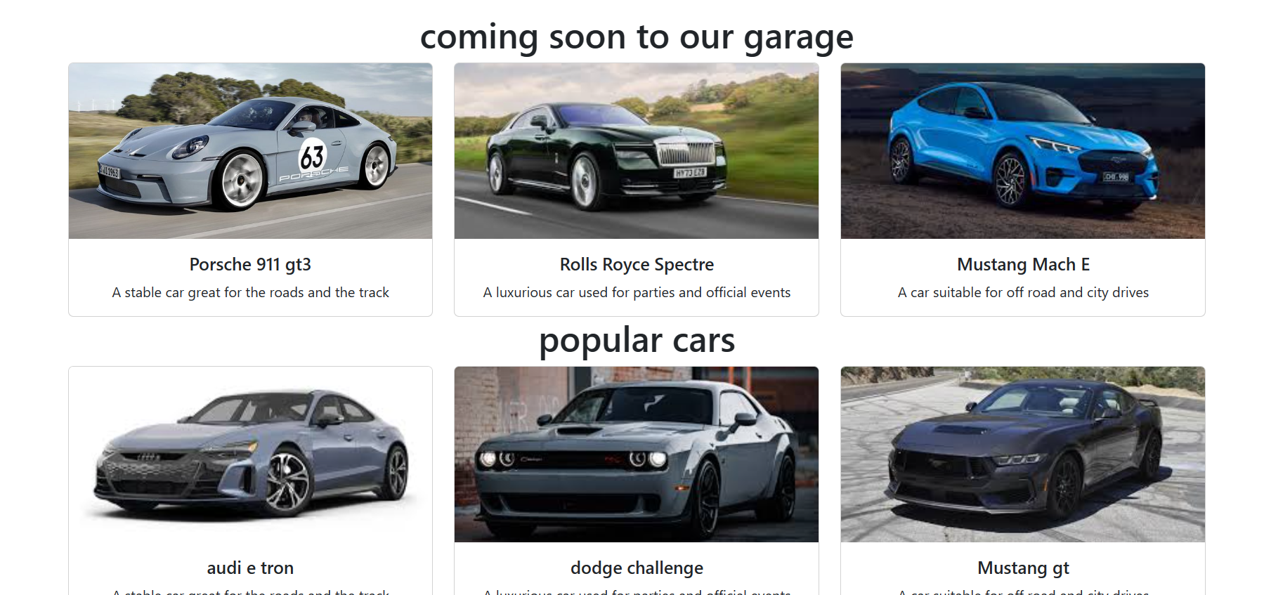
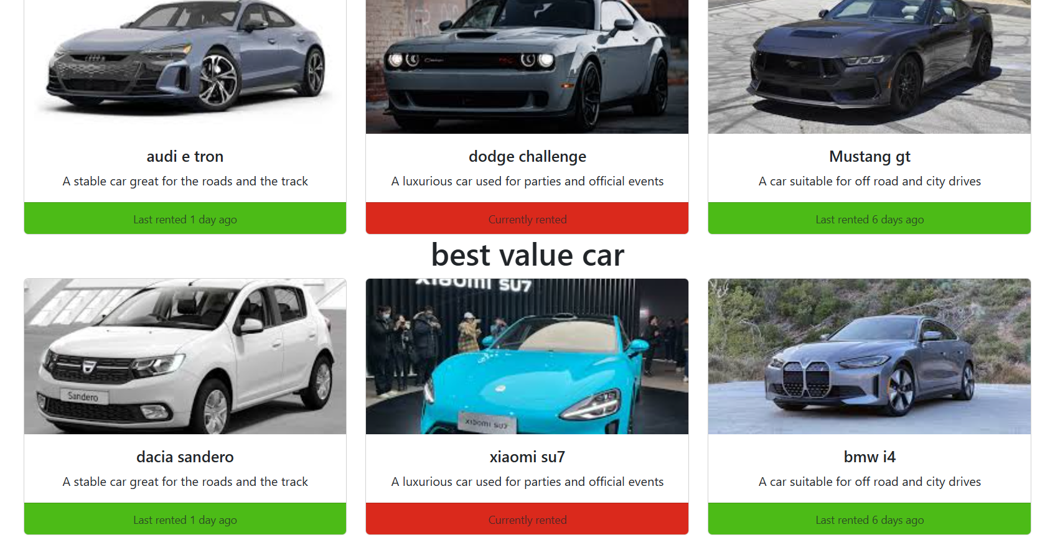
Home page

Slide 5
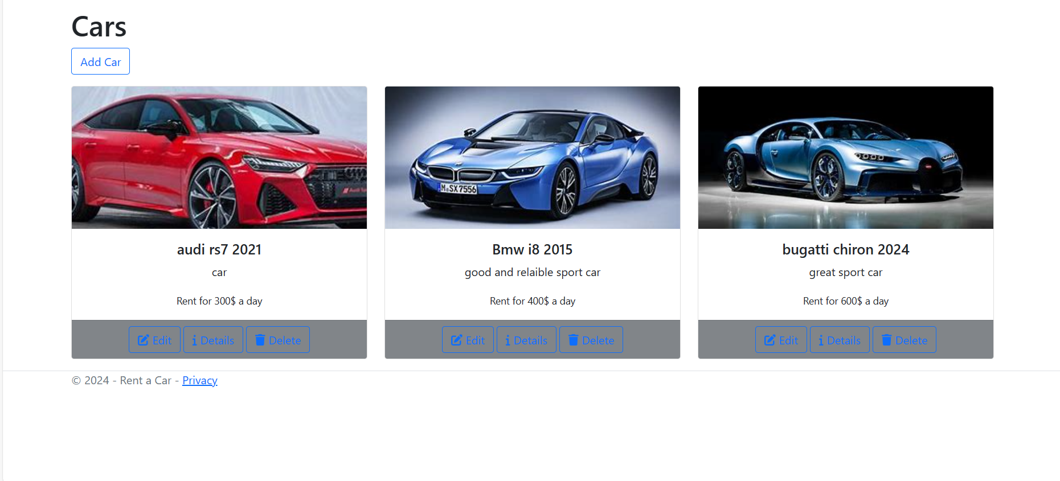
Car
List of all cars

Slide 6
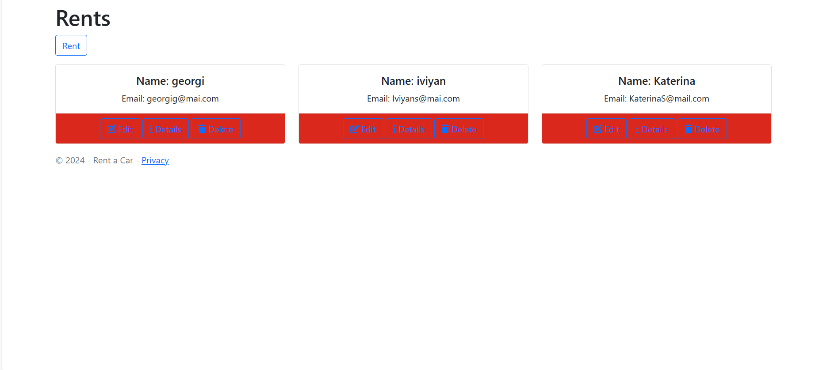
Rent
A list with the tenants

Slide 7
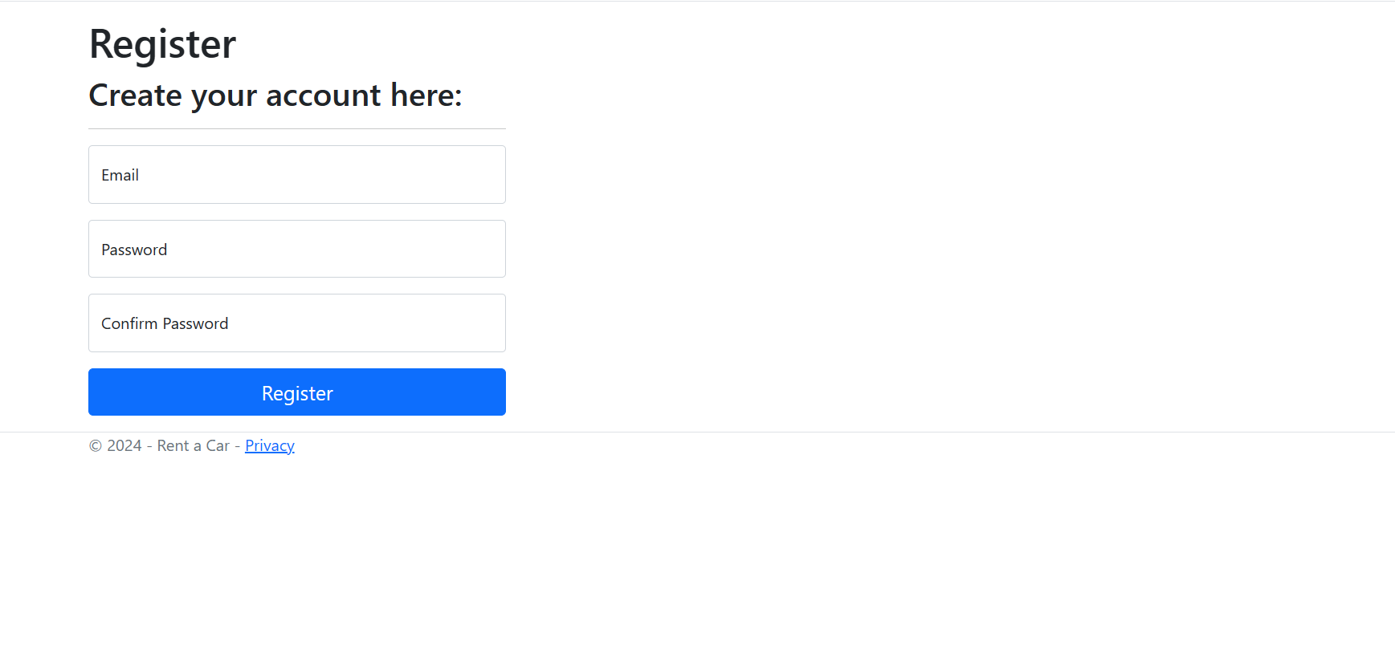
register
A place to create your account

Slide 8
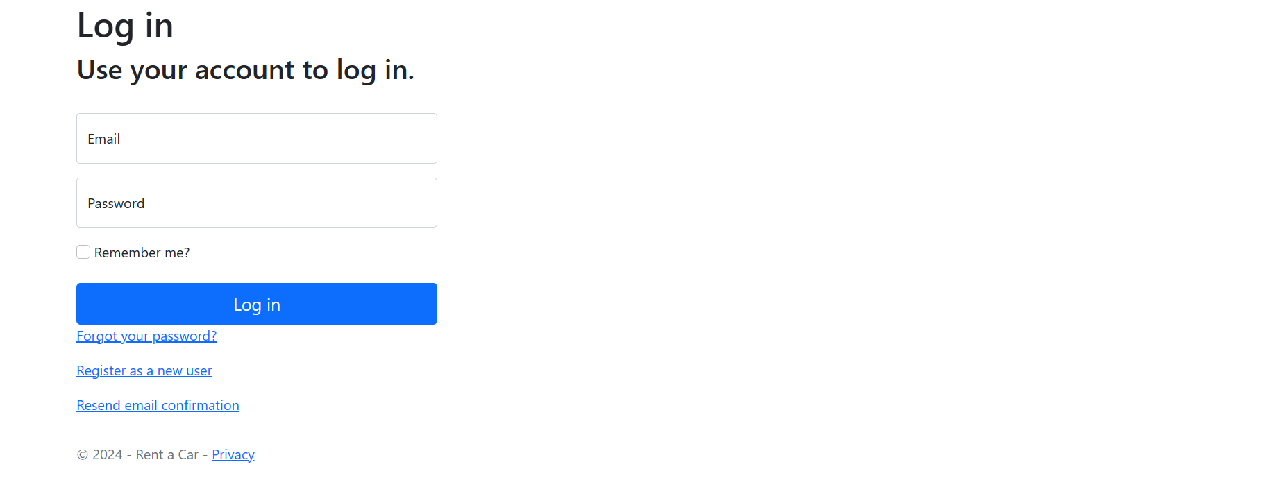
Log in
A place to log into your account

Slide 9

thanks for the attention

